Slide 1
ReactJS
State and Props

Slide 2
Agenda
Components
State
Props
Props vs State
Default Props
Validating Props
Nested Component
Exercise

Slide 3
State
Each component can store it’s own local information in it’s state
- Private and fully controlled by the component
- Can be passed as props to children
- Its scope is limited to the current component.
Only class component can have local state
const MenuItem = (props) => {
//can not have state.
}

Slide 4
State
State declared within the constructor:
State should only be modified by setState:
Never do the following: this.state.selectedDish = dish;
The state of the parent component usually ends up being props of the child component

Slide 5
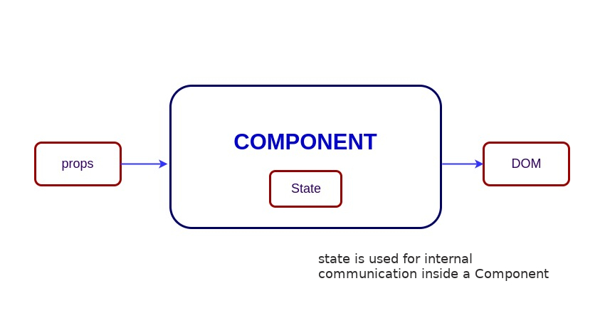
State
Example : https://github.com/priya1091992/React--State-and-Props

Slide 6
State
Default State -> ES5
var MyComponent = React.createClass({
getInitialState() {
return { /* initial state */ };
},
});

Slide 7
State
Default State -> ES6
class MyComponent extends React.Component {
constructor(props) {
super(props);
this.state = { /* initial state */ };
}
}

Slide 8
State
State modification and component updates
class example extends React.Component{
constructor(props){
super(props);
this.state={
inputValue: '' "
}
}
onChange(e) {
this.setState({ inputValue: e.target.value });
}

Slide 9
State
State modification and component updates
render() {
return (
<input
type='text'
value={this.state.inputValue}
onChange={this.onChange} />
)}
}
Whenever this.state is updated the component will be re-rendered, causing the input value to reflect what the user typed.

Slide 10
Props
Props (short for properties) are a Component's configuration.
Received from parent and immutable.
A Component cannot change its props, but it is responsible for putting together the props of its child Components.
Props do not have to just be data -- callback functions may be passed in as props.

Slide 11
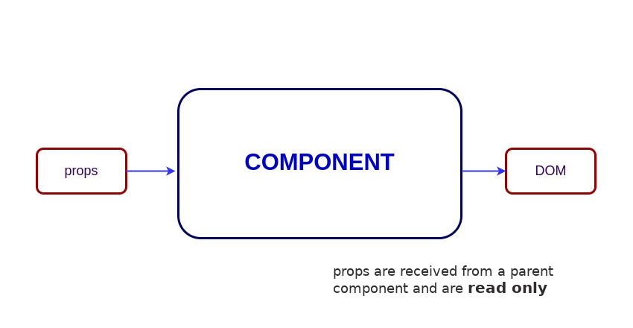
Props

Slide 12
Props
Handling Events: Handling events is similar to the way you handle events on DOM elements:
Use camelCase to specify events
Pass functions as the event handler
Example:
<Card onClick={()=>this.onDishSelect(dish)}/>

Slide 13
Default Props
To set the default props use getDefaultProps in the component. (ES5)
var Greeting = React.createClass({
propTypes: {
name: React.PropTypes.string },
getDefaultProps: function() {
return {
name: 'Mary'
};
},
});

Slide 14
Default Props
To set the default props set the class.defaultProps in the component. (ES6)
class Greeting extends React.Component {
// ...
}
Greeting.defaultProps = {
name: 'Mary'
};

Slide 15
Validating Props
We can also specify what type of props a component is expecting by specifying the proptypes.
Syntax :
<ClassName>.proptypes = {
<propName> : <propType>
}

Slide 16
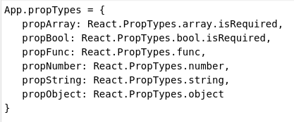
Validating Props
If types does not match, react warns us about react validation failing.

Slide 17
Changing props and state
props state Can get initial value from parent Component? Yes Yes Can set default values inside Component?* Yes Yes Can change inside Component? No Yes Can set initial value for child Components? Yes Yes Can change in child Components? No No
Note that both props and state initial values received from parents override default values defined inside a Component.

Slide 18
Nested Component
import BankAccountsSearch from './BankAccountsSearch'
Nested Components are exactly what the name implies. They are children nested inside parent components. They simply help us create more complex UI structures. For example, an alert component probably has another sub-component nested within it to indicate the actual number of alerts.
Example: http://www.reactjstutorial.net/nested-components.html

Slide 19
Exercise-State Manipulation
implement a page showing 3 counters
every counter has a + and a - button
for every counter, clicking on + will increase the count number on that single counter
for every counter, clicking on - will decrease the count number on that single counter
the page will have 2 extra buttons "decrease all" and "increase all"
clicking on "increase all" will increase the count by one unit on all the counters
clicking on "decrease all" will decrease the count by one unit on all the counters

Slide 20
Exercise-Props
Create MenuContainer class that will have dishes list in it’s own state. Pass that list in a child Dishes Component
Render Dishes list(each dish should be rendered as a separate component like Dish) from Dishes component.
On clicking of Dish card -> console additional details of particular dish like cost, etc..
Add a button named Add Dish inside Dishes component after dish list
On clicking of Add button, It should add a dish.

Slide 21
Exercise-Props
Menu
Dishes
Dish
Dish
.
.
.
Dish
Add Dish

Slide 22


